Slide 1
Omáda Networking Platform Remote Work Collaboration
Tech Titans 2
Vaidik Sule; Akshat thakur; Veer Adyani; Chirag Kewlani
Date of Presentation: 29/04/2024

Slide 2
Project Overview
Omada Networking Platform is a remote work collaboration tool designed to empower teams to work together effortlessly, regardless of geographical barriers. Developed within the intense timeframe of a 36-hour hackathon, our platform embodies innovation, creativity, and a passion for advancing the way teams collaborate remotely.
Technologies Used Are: HTML, CSS, JavaScript

Slide 3
Key Features Overview
Video Conferencing
Time Zone Conversion
Chat Bot
File Sharing
Friends Management

Slide 4
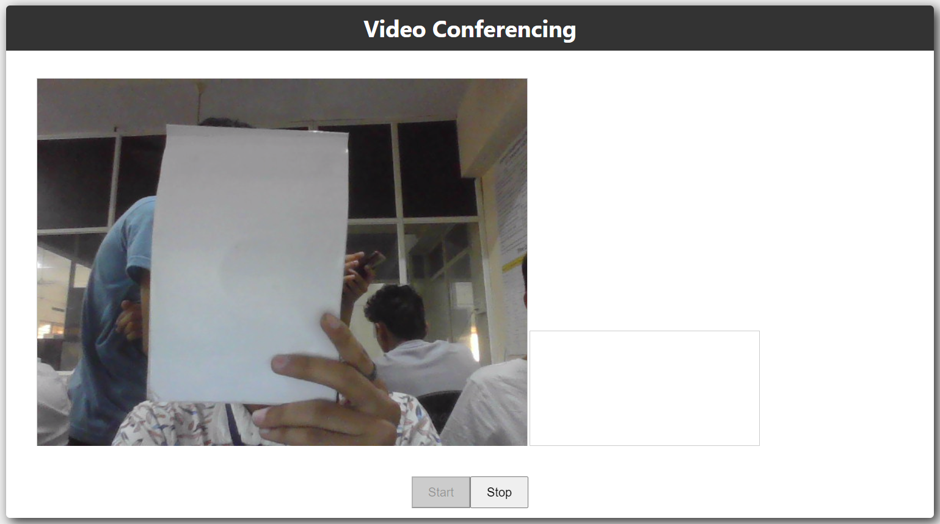
Video Conferencing
Engage in face-to-face communication with your team members through our integrated video conferencing feature. Collaborate in real-time, brainstorm ideas, and make decisions with confidence.

Slide 5
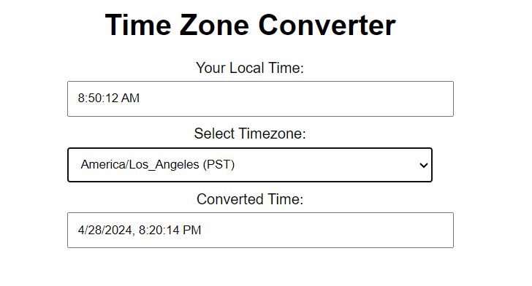
Time Zone Conversion
Say goodbye to the hassle of coordinating across different time zones! Our platform automatically converts time zones, ensuring everyone is synchronized and on the same page, no matter where they are in the world.

Slide 6
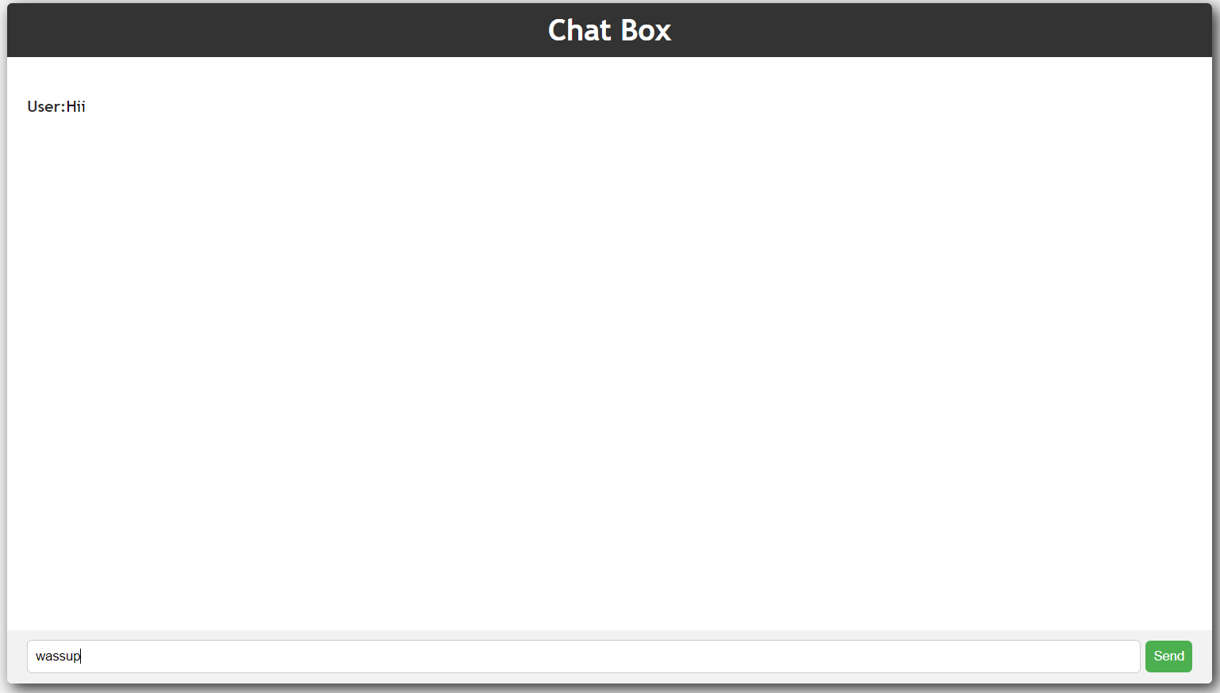
Chat Bot
Foster communication and collaboration with our intuitive chat box. Share updates, exchange ideas, and keep the conversation flowing in real-time.

Slide 7
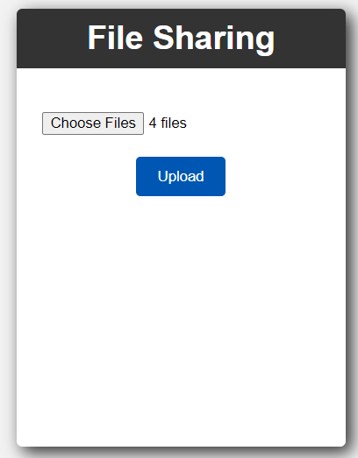
File Sharing
Streamline collaboration by sharing files, documents, and resources seamlessly within the platform. From project plans to design files, our file sharing feature ensures that everyone has access to the information they need to succeed.

Slide 8
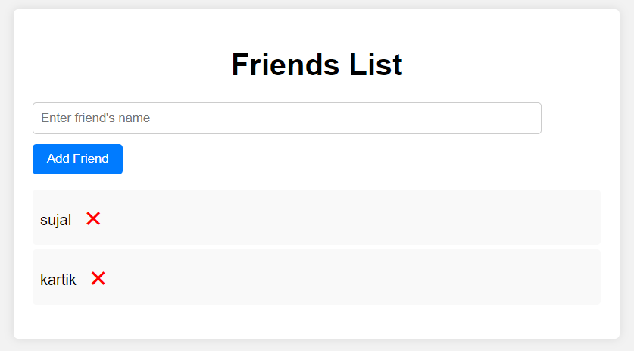
Friends Management
Build and maintain your professional network effortlessly with our friend management feature. Add, remove, or maintain your friend list with ease, fostering connections and collaboration within your community.

Slide 9
Future Roadmap
We are committed to continuous improvement and have ambitious plans for the future of the Omada Networking Platform. In the coming months, we aim to introduce different channels for various projects and applications, enhancing work distribution and streamlining collaboration. Additionally, we are exploring opportunities to integrate advanced features to further enhance the remote work experience for our users.

Slide 10
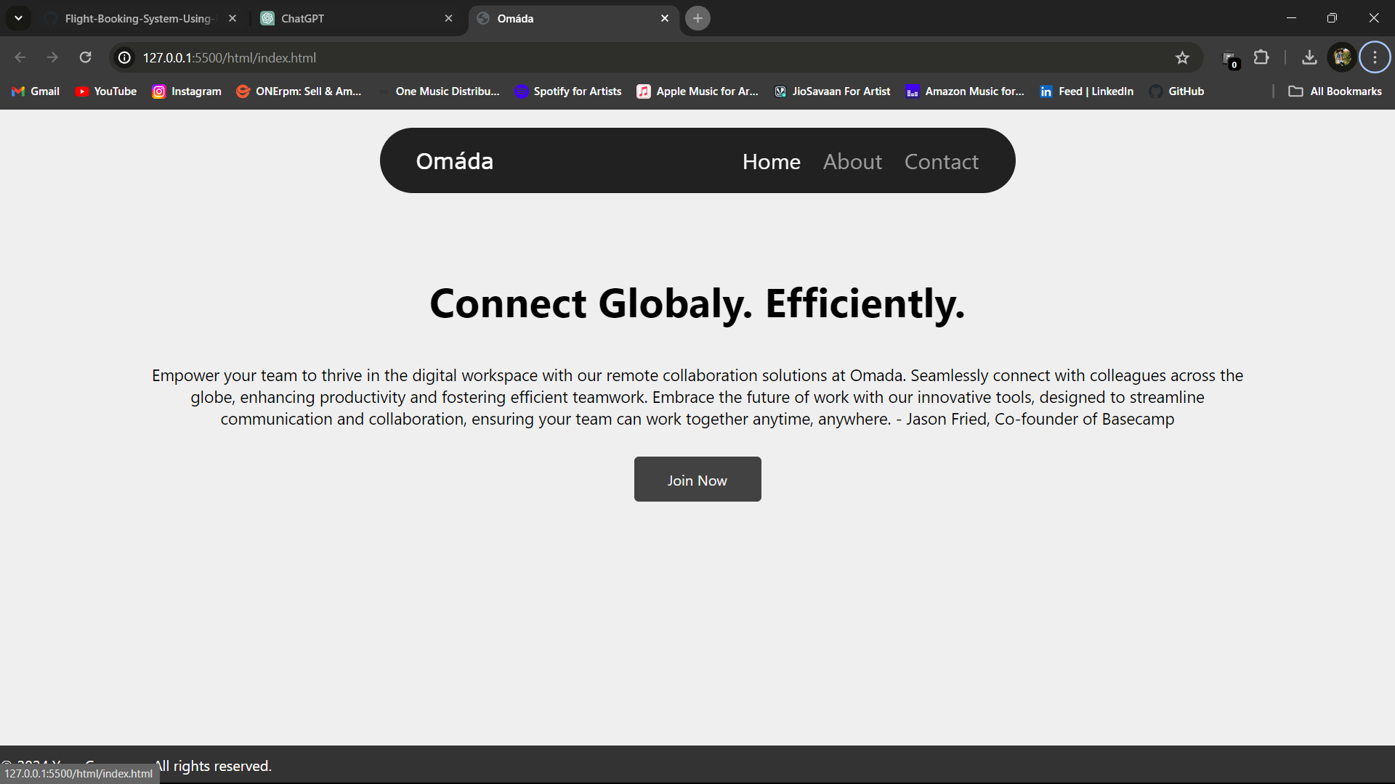
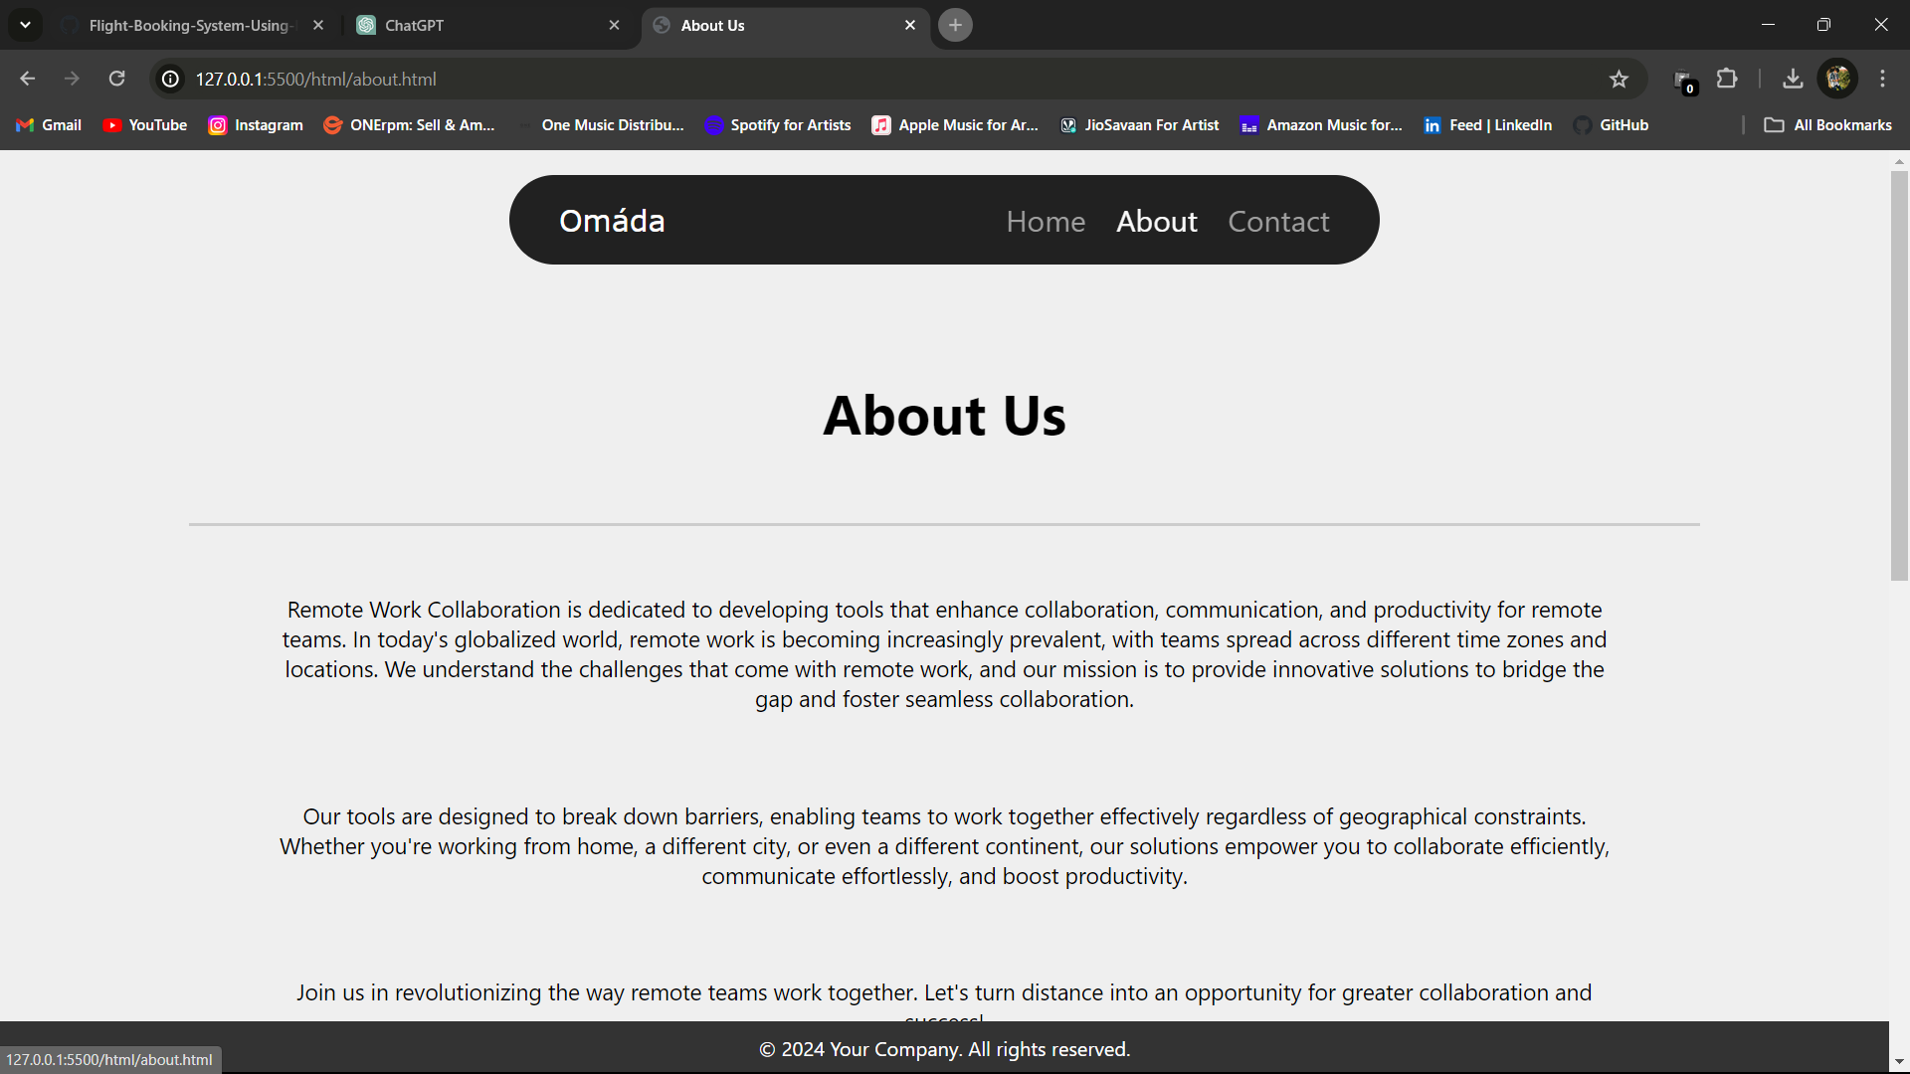
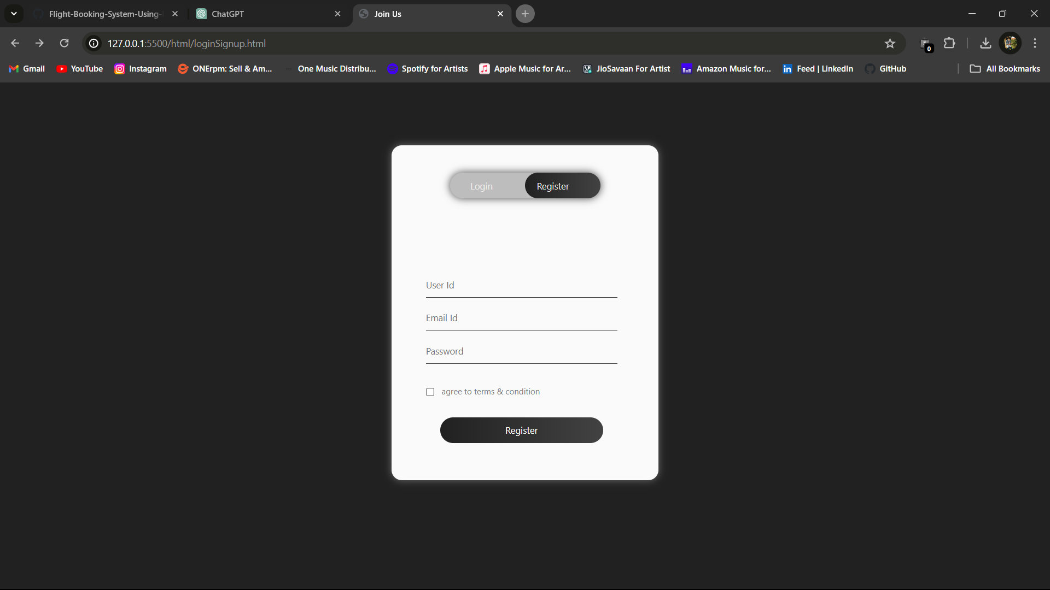
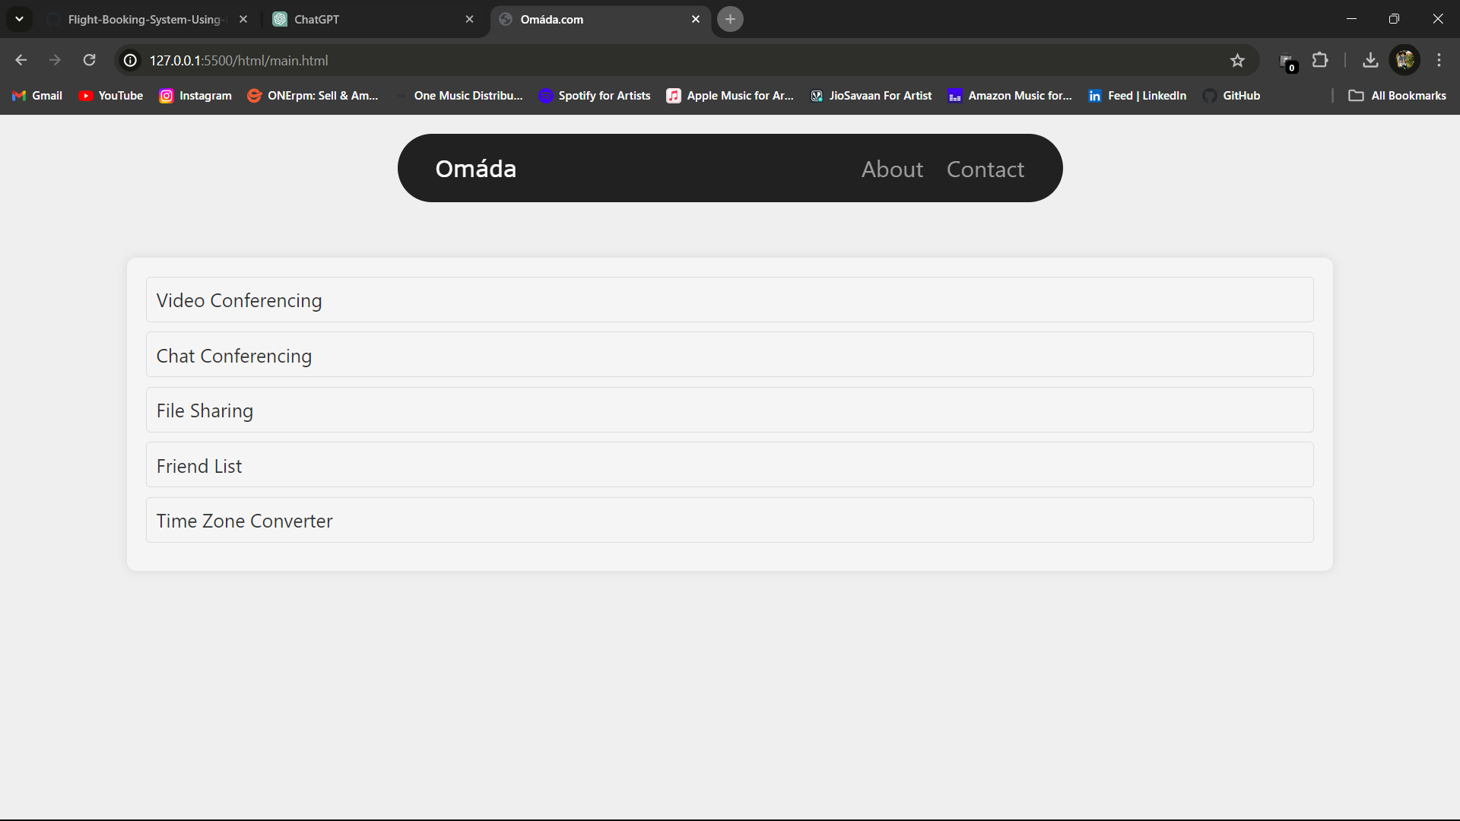
Glimpse Of Our Platform

Slide 11
Thank You
Join us on this exciting journey as we revolutionize remote collaboration and empower teams to achieve their goals together, no matter where they are in the world. Welcome to the Omada Networking Platform – where collaboration knows no boundaries!

